Slide 1
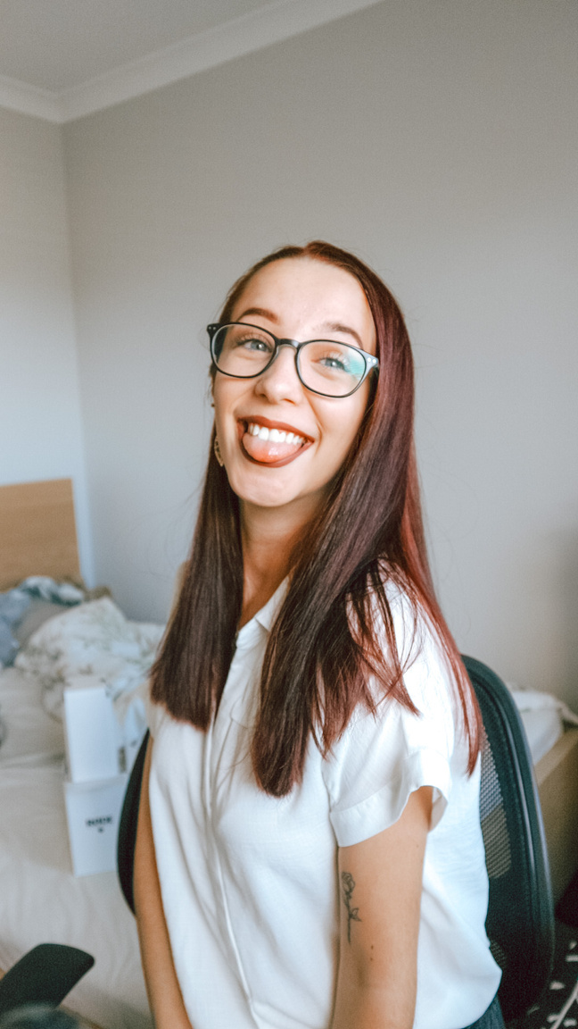


ABI MOSS
UGC Creator

Slide 2
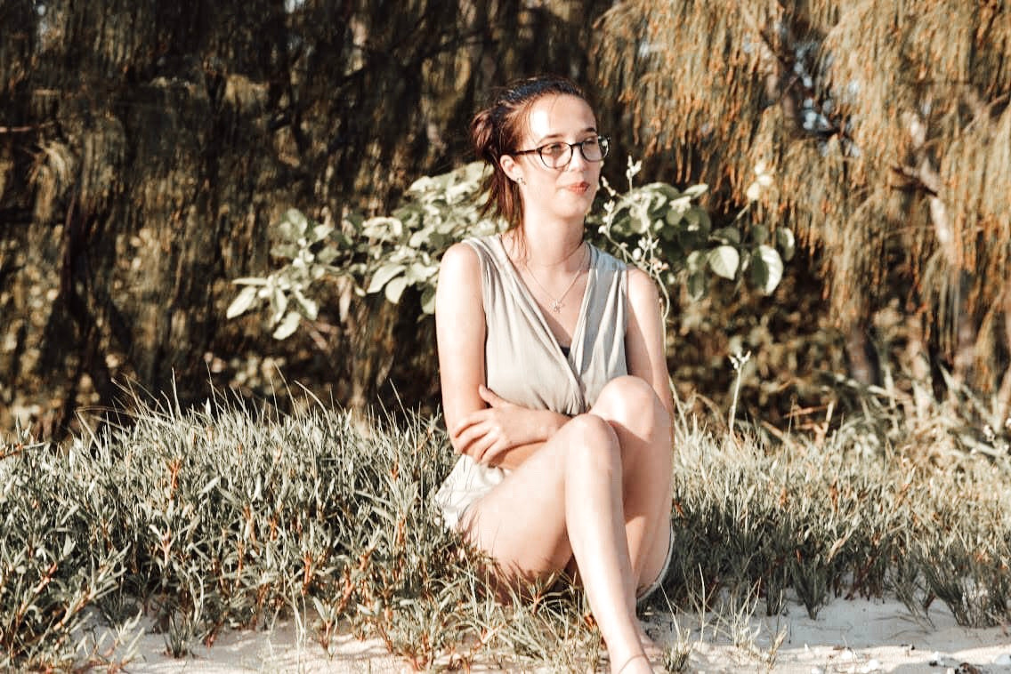
ABOUT ME
I’m a creative, detail-driven UGC creator with a background in sales, marketing, and storytelling—skilled in producing authentic, high-quality content that builds trust and drives results. With a keen eye for aesthetics and a passion for visual storytelling, I create relatable, scroll-stopping content that feels natural to the viewer while aligning seamlessly with your brand’s message.
Whether I’m scripting short-form videos, photographing lifestyle shots, or reviewing products, I approach every project with energy, creativity, and a strong understanding of what resonates with today’s audiences. I’m easy to work with, adaptable across industries, and committed to producing content that converts, connects, and elevates your brand.

Slide 3



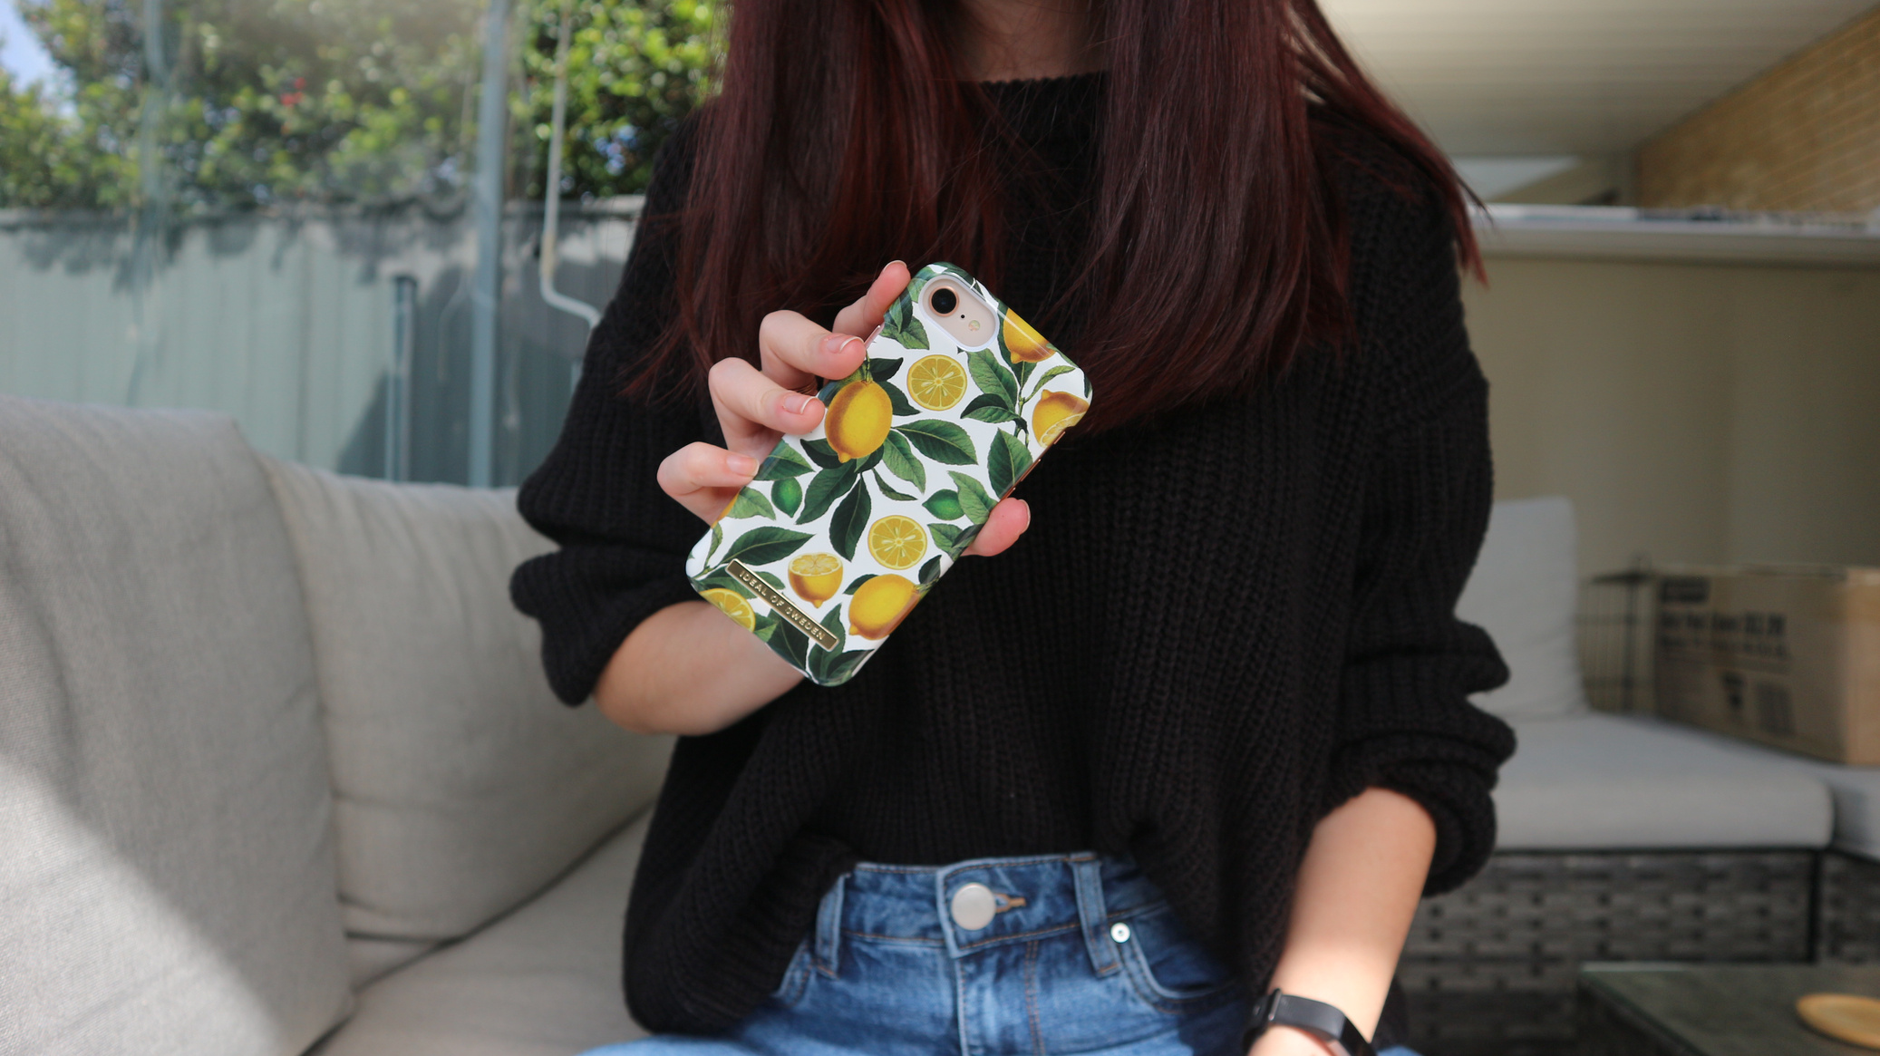
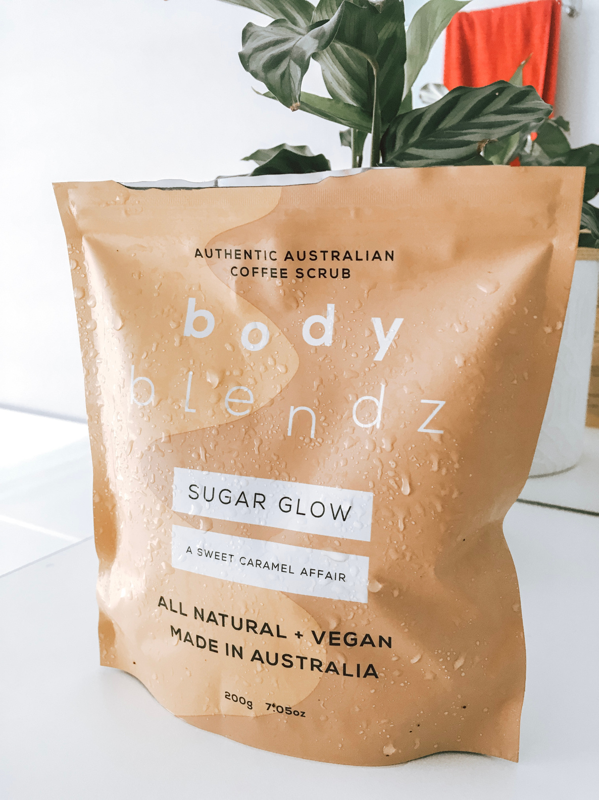
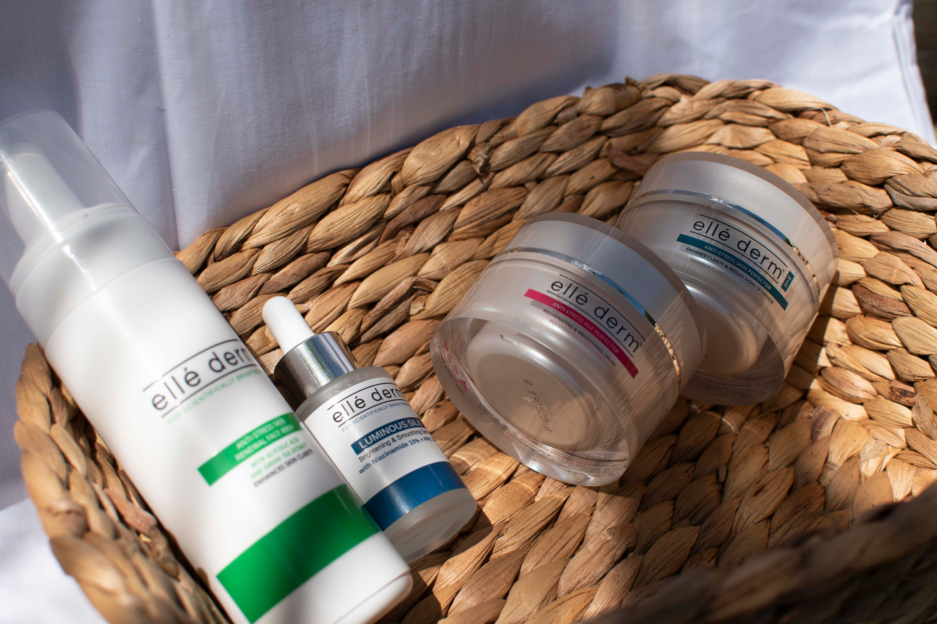
PAST CLIENTS
IDEAL OF SWEDEN
BODY BLENDZ
ELLE DERM
Creating content for their brand new phone cases (2021) - this was primarily focused on providing images for their Instagram and EDMs
A continuing partnership from 2019 - 2021 photographing new products for them to showcase on social media platforms
A continuing partnership revolving around the idea of showcasing their clean ingredients and proving their target audience for people in their early 20s and upwards.

Slide 4
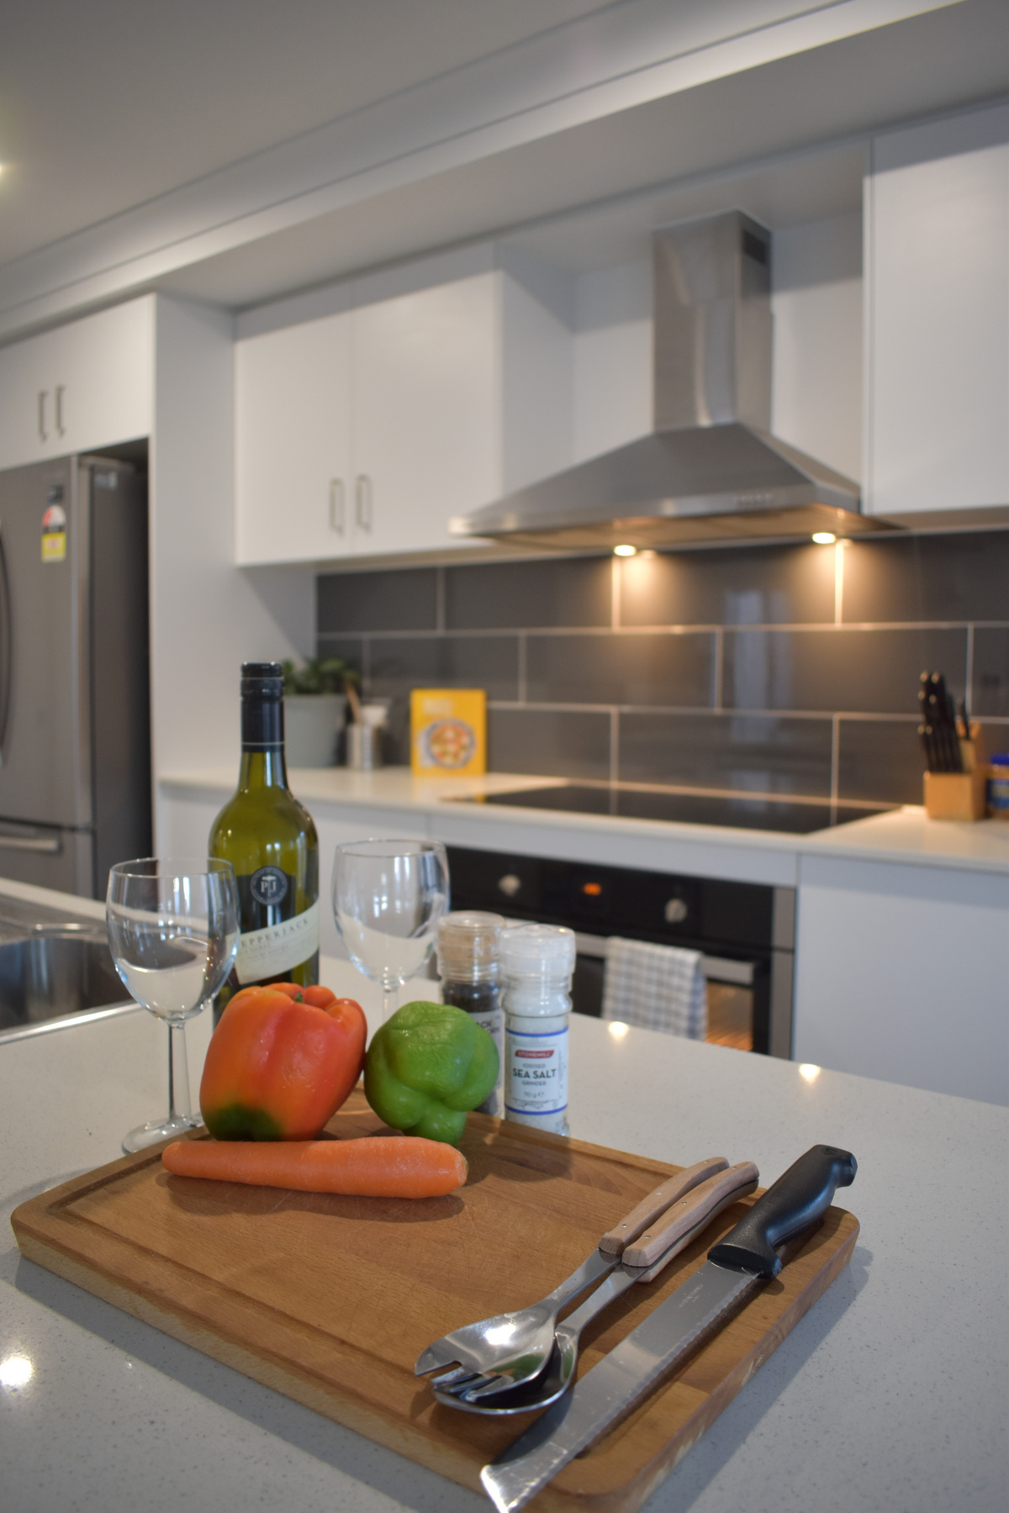
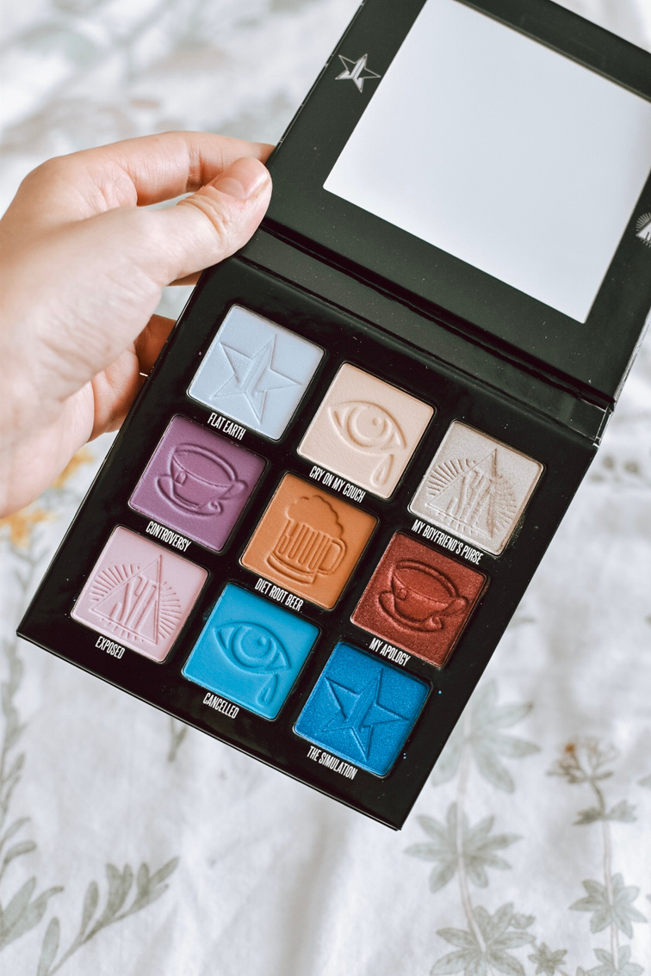
PRODUCT AND LIFESTYLE PHOTOGRAPHY

Slide 5
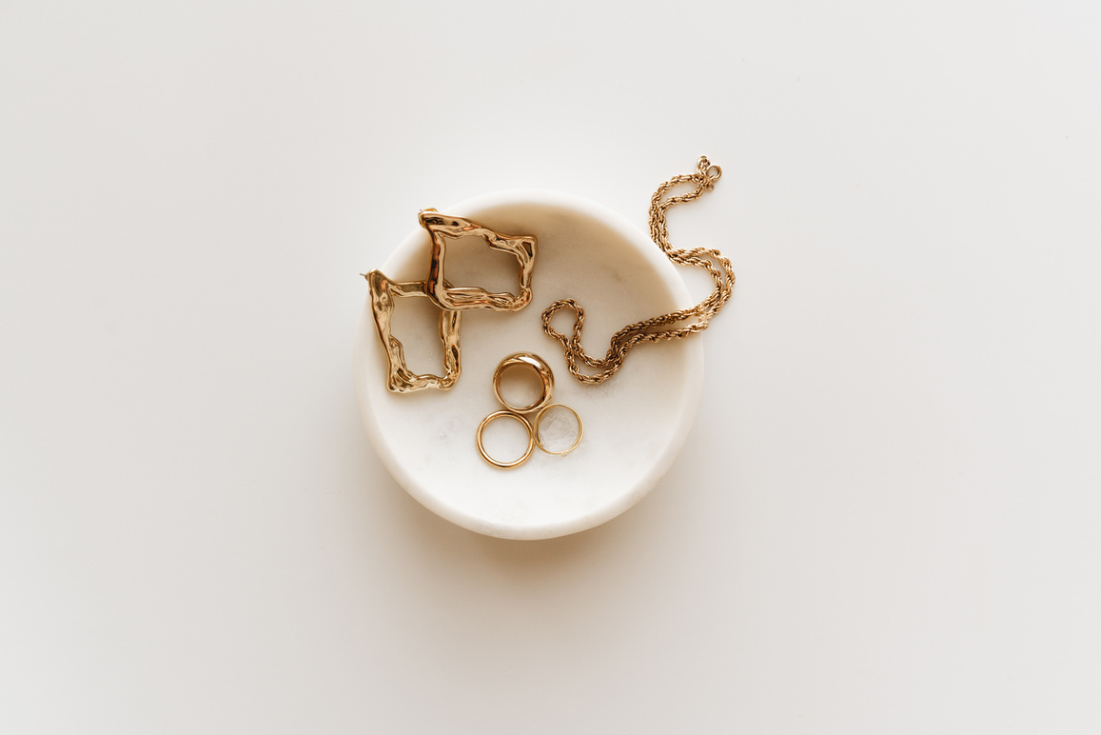

MY SERVICES
$ RATES ARE AVAILABLE UPON REQUEST $
UGC PHOTOS AND VIDEOS
1 UGC VIDEO INCLUDES
  Concept and script
  UGC ads
  Organic content
  Voiceover Videos
  UGC photos
  Product photography
  Content bundles
  Monthly retainer
  1 UGC video includes:
  Vertical format (9:16)
  Research on branding & concepts
  Scriptwriting
  Video filming & editing
  2 revisions if needed

Slide 6
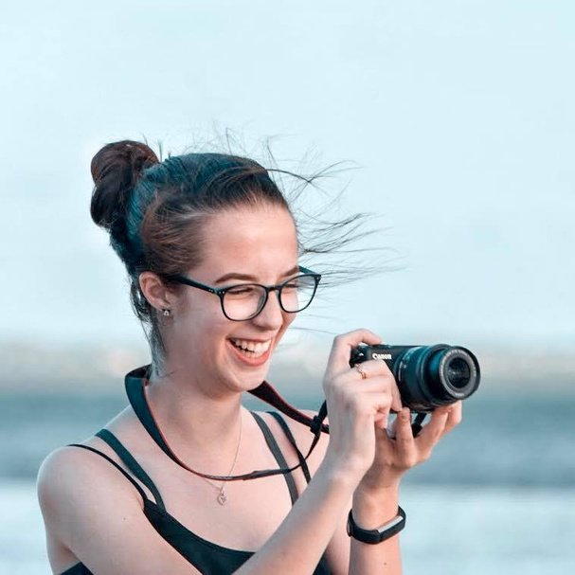
LET'S WORK
TOGETHER!
ugcbyabi@outlook.com.au
BOOK A DISCOVERY CALL WITH ME
Find me on Social Media:

